Slide 1
Qualtrics tips at CSU Student Affairs Training
Mike Brake, 1/28/2020

Slide 2
Introductions
Who are you and what is one data item you find most interesting?

Slide 3
Goals!
What would you like to get out of this session today?

Slide 4
Qualtrics Online Help
It’s really well done!
https://www.qualtrics.com/support/survey-platform/getting-started/survey-platform-overview/

Slide 5
Most of this presentation is interactive
Login to http://colostate.qualtrics.com

Slide 6
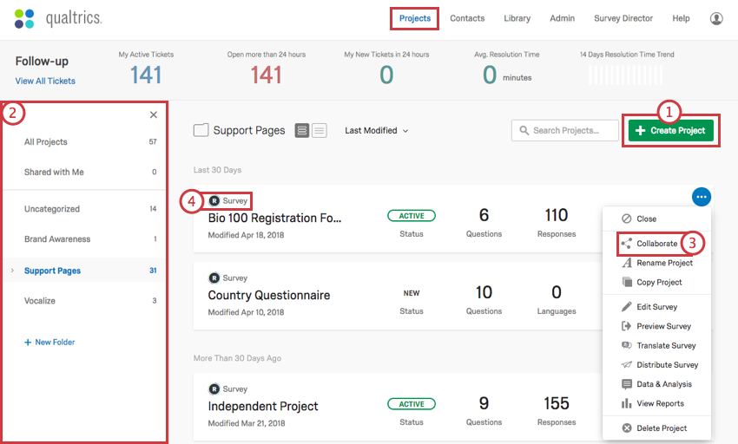
Qualtrics Projects Panel

Slide 7
Question Types: Favorites
Qualtrics Survey Pane
Text Entry
Multiple Choice
Matrix Table
Descriptive Text for instructions!

Slide 8
Changing questions
Based on participant answers
Based on data you know ahead of time
Based on randomness
Other?

Slide 9
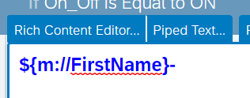
Changing question/answer options
Skip Logic
Display Logic
Piped answers

Slide 10
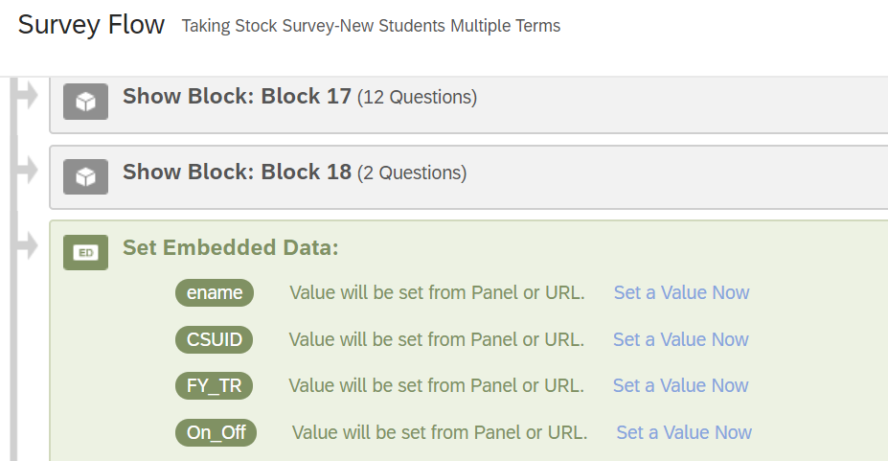
Big chunks showing/hiding?
Survey Flow!!!!

Slide 11
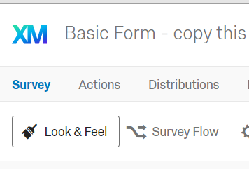
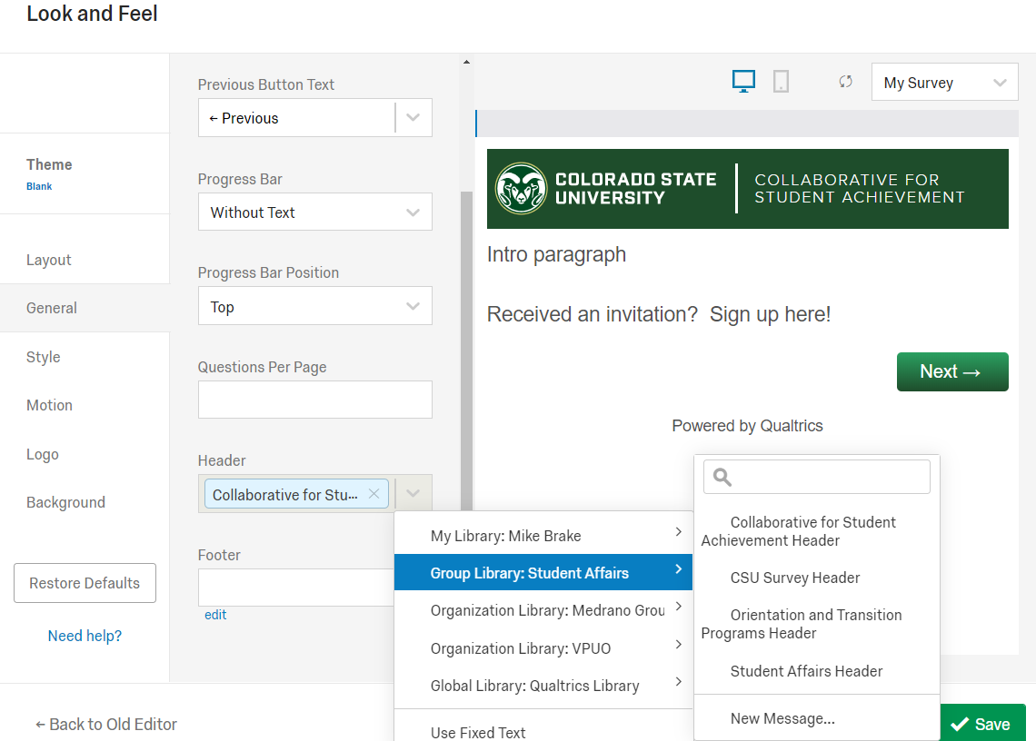
CSU look and feel
Survey Creation
Student Affairs has a Library. Feel free to save your customizations to it and look for those we have already created
General Tab, then the Header drop down box

Slide 12
Edit the CSU Survey Header
Additional Tips
Click the Blue X:
An ‘edit’ link will appear. Click that and look for the SURVEY words and replace them with what you want.
You can adjust colors and background
For accessibility, change the → and ← arrows to also say Next → and ← Previous

Slide 13
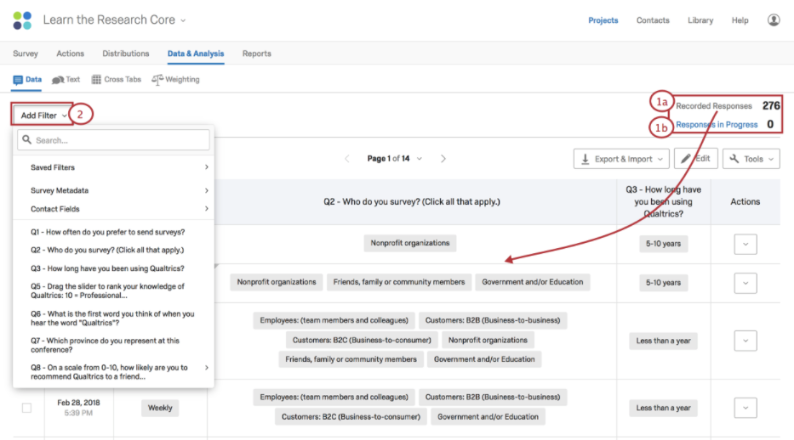
Qualtrics Data and Analysis

Slide 14
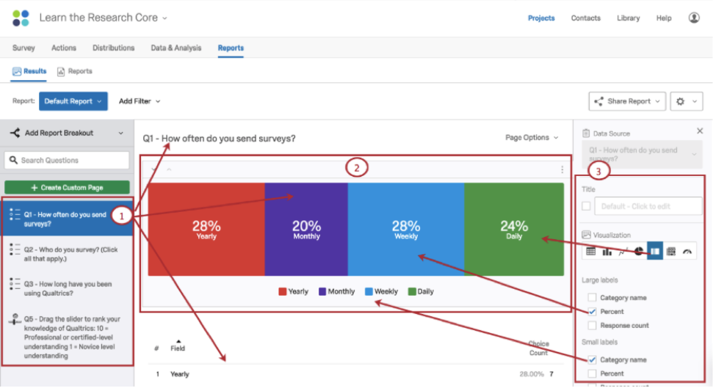
Qualtrics Reports

